Slide 1
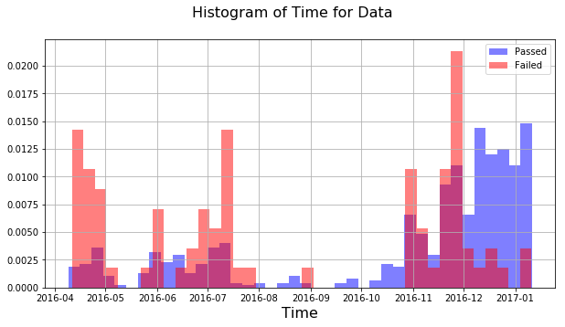
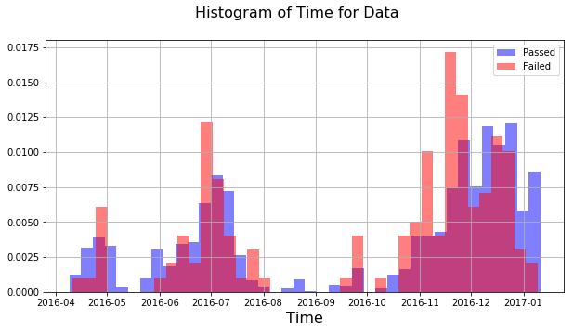
Looking at Passed/Failed Units in Time
SMSR2 < 45
SMSR2 >= 45
Time <= Jan 10, 2017
After removing data for SMSR2 < 45
Number of passed units → 15096
  Previously we had 15779 passed units, so, 683 passed units had SMSR2<45
Number of failed units → 145
  Previously we had 227 failed units, so, 82 failed units had SMSR2 < 45.
  In the next slides, we analyzed the units with SMSR2 >= 45.

Slide 2
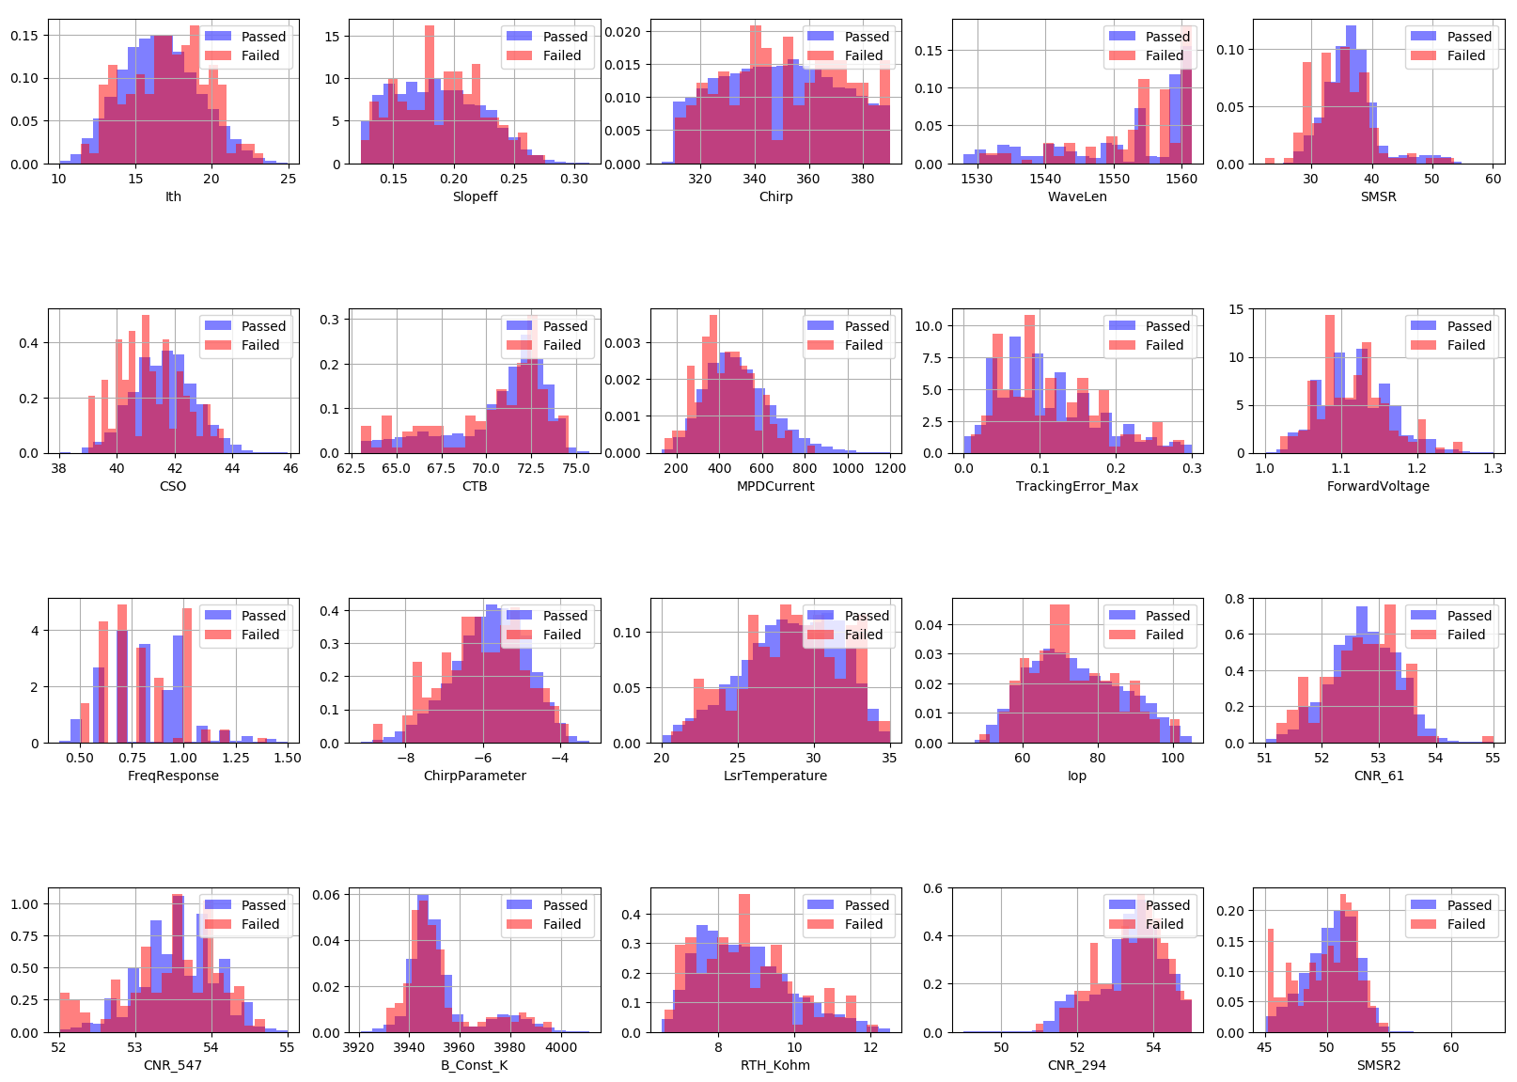
Histograms of Different Features

Slide 3
Correlation Between Different Features
ChirpParameter
-0.92
-0.43
-0.79
Ith
Iop
Slopeff
Forward
Voltage
0.45
-0.96
0.78
0.58
0.62
SMSR2
SMSR
CNR_547
CNR_61
CNR_294
0.45
0.68

Slide 4
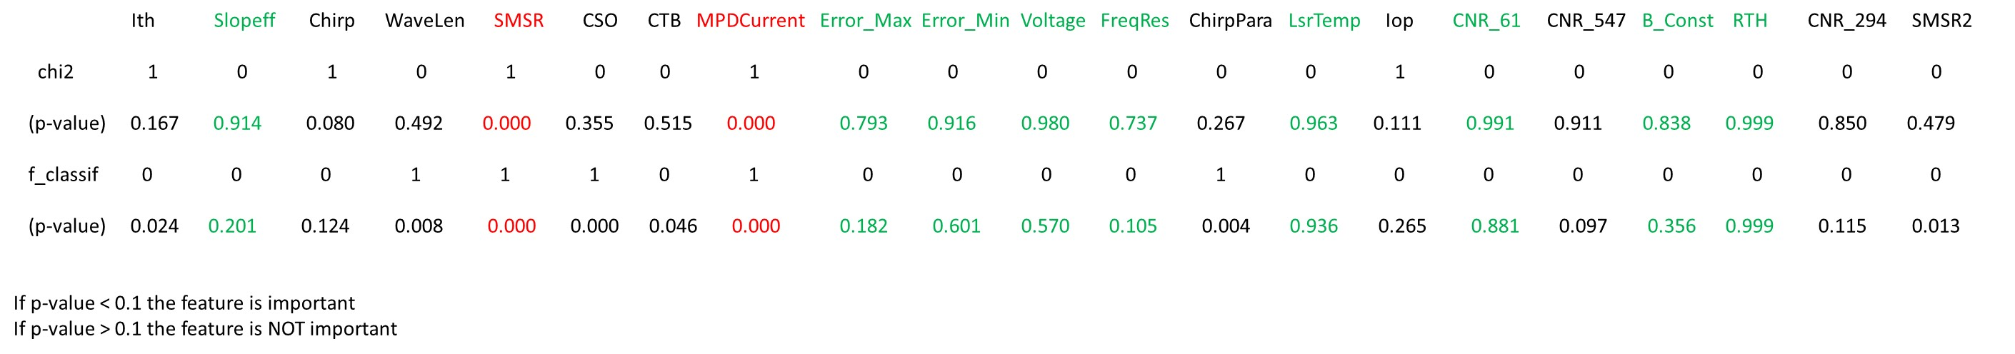
Hypothesis Test on Feature Importance
Based on the linear dependency test (F-test) and total dependency test (chi2), we get the following conclusions:
The following features are important to predict the failed units.
  SMSR, MPDCurrent
The following features are not important with a very high probability:
  RTH_Kohm, LaserTemprature, CNR-61,ForwardVoltage, TrackingError_Min, B_const_K, Slopeff, TrackingError_Max, FrequencyResponse

Slide 5
Machine Learning Model on Feature Importance
Feature | Feature Importance Value
SMSR | 0.1006
CSO | 0.0796
SMSR2 | 0.0752
CTB | 0.0611
MPDCurrent | 0.0596
CNR_547 | 0.0591
ChirpParameter | 0.0535
B_Const_K | 0.0499
WaveLen | 0.0485
Iop | 0.0473
Ith | 0.0453
Slopeff | 0.0431
Chirp | 0.0413
LsrTemperature | 0.0387
RTH_Kohm | 0.0380
TrackingError_Min | 0.0338
CNR_294 | 0.0332
TrackingError_Max | 0.0315
CNR_61 | 0.0277
ForwardVoltage | 0.0212
FreqResponse | 0.0115

Slide 6
Clustering Results
Total Failure Percentage = 0.95%
7 Clusters
cluster 0: number of passed = 1296, number of failed = 3, failure Percentage = 0.23 %
cluster 1: number of passed = 3060, number of failed = 44, failure Percentage = 1.41 %
cluster 2: number of passed = 3043, number of failed = 27, failure Percentage = 0.87%
cluster 3: number of passed = 3451, number of failed = 31, failure Percentage = 0.89 %
cluster 4: number of passed = 421, number of failed = 1, failure Percentage = 0.23 %
cluster 5: number of passed = 2247, number of failed = 16, failure Percentage = 0.70 %
cluster 6: number of passed = 1578, number of failed = 23, failure Percentage = 1.43 %
 | Cluster 0 Center | Cluster 1 Center | Cluster 2 Center | Cluster 3 Center | Cluster 4 Center | Cluster 5 Center | Cluster 6 Center
Ith | 16.9579 | 16.4120 | 16.6261 | 16.4685 | 17.4239 | 16.8205 | 16.6444
Slopeff | 0.1653 | 0.1997 | 0.1809 | 0.1904 | 0.1504 | 0.1728 | 0.2072
Chirp | 350.7828 | 347.7672 | 349.8599 | 349.0855 | 353.0758 | 351.1757 | 347.0234
WaveLen | 1550.8480 | 1550.7874 | 1552.4162 | 1551.5412 | 1549.5746 | 1552.3658 | 1549.5223
SMSR | 36.8149 | 36.5661 | 36.3681 | 36.5150 | 36.6033 | 36.6373 | 36.7048
CSO | 41.6348 | 41.6541 | 41.6111 | 41.6167 | 41.5235 | 41.5951 | 41.6490
CTB | 69.9151 | 71.0005 | 70.8855 | 71.1282 | 69.6647 | 70.5083 | 70.7736
MPDCurrent | 750.0478 | 359.8966 | 530.2547 | 444.6453 | 933.8239 | 627.9927 | 261.2766
TrackingError_Max | 0.1089 | 0.1100 | 0.1077 | 0.1087 | 0.1025 | 0.1069 | 0.1098
TrackingError_Min | -0.1309 | -0.1396 | -0.1332 | -0.1386 | -0.1259 | -0.1332 | -0.1420
ForwardVoltage | 1.1385 | 1.1069 | 1.1187 | 1.1124 | 1.1583 | 1.1287 | 1.1070
FreqResponse | 0.8396 | 0.8048 | 0.8193 | 0.8191 | 0.8328 | 0.8284 | 0.8075
ChirpParameter | -5.9417 | -5.7085 | -5.8150 | -5.7482 | -6.1455 | -5.9020 | -5.7769
LsrTemperature | 28.6654 | 28.4681 | 28.3780 | 28.4710 | 28.9744 | 28.5617 | 28.4459
Iop | 81.3611 | 69.8867 | 75.7912 | 72.6174 | 87.1664 | 78.7057 | 68.2449
CNR_61 | 52.5698 | 52.7200 | 52.6697 | 52.7024 | 52.5476 | 52.6285 | 52.7360
CNR_547 | 53.5307 | 53.5207 | 53.5541 | 53.5404 | 53.5194 | 53.5572 | 53.4780
B_Const_K | 3952.7932 | 3952.2290 | 3952.2562 | 3952.3819 | 3954.0427 | 3952.6671 | 3952.7726
RTH_Kohm | 8.6265 | 8.6983 | 8.7420 | 8.7004 | 8.5148 | 8.6724 | 8.7080
CNR_294 | 53.2456 | 53.3768 | 53.3209 | 53.3473 | 53.1555 | 53.2826 | 53.3774
SMSR2 | 50.1587 | 50.3559 | 50.3973 | 50.3784 | 50.0141 | 50.3804 | 50.4469

Slide 7
Clustering Results
Total Failure Percentage = 0.95 %
5 Clusters
cluster 0: number of passed = 4609, number of failed = 51, failure Percentage = 1.09 %
cluster 1: number of passed = 2608, number of failed = 18, failure Percentage = 0.68 %
cluster 2: number of passed = 4247, number of failed = 34, failure Percentage = 0.79 %
cluster 3: number of passed = 870, number of failed = 1, failure Percentage = 0.11 %
cluster 4: number of passed = 2762, number of failed = 41, failure Percentage = 1.46 %
 | Cluster 0 Center | Cluster 1 Center | Cluster 2 Center | Cluster 3 Center | Cluster 4 Center
Ith | 16.4331 | 16.8751 | 16.6145 | 17.2566 | 16.5438
Slopeff | 0.1938 | 0.1704 | 0.1811 | 0.1564 | 0.2057
Chirp | 348.7890 | 350.8276 | 349.9310 | 352.2294 | 346.9625
WaveLen | 1551.3874 | 1551.8659 | 1552.3395 | 1550.0644 | 1549.7504
SMSR | 36.4908 | 36.7238 | 36.4385 | 36.6097 | 36.7022
CSO | 41.6164 | 41.6137 | 41.6099 | 41.5621 | 41.6781
CTB | 71.1202 | 70.2863 | 70.9054 | 69.7564 | 70.8042
MPDCurrent | 411.8419 | 666.4896 | 528.1157 | 864.5526 | 291.6668
TrackingError_Max | 0.1088 | 0.1078 | 0.1080 | 0.1049 | 0.1103
TrackingError_Min | -0.1393 | -0.1324 | -0.1338 | -0.1280 | -0.1412
ForwardVoltage | 1.1100 | 1.1319 | 1.1189 | 1.1511 | 1.1061
FreqResponse | 0.8123 | 0.8288 | 0.8211 | 0.8443 | 0.8075
ChirpParameter | -5.7311 | -5.9149 | -5.8117 | -6.0722 | -5.7420
LsrTemperature | 28.4634 | 28.5853 | 28.3710 | 28.9827 | 28.4900
Iop | 71.5598 | 79.6055 | 75.6653 | 84.8161 | 68.4929
CNR_61 | 52.7121 | 52.6138 | 52.6705 | 52.5372 | 52.7278
CNR_547 | 53.5360 | 53.5458 | 53.5520 | 53.5246 | 53.4933
B_Const_K | 3952.2912 | 3952.6246 | 3952.2527 | 3953.9018 | 3952.6175
RTH_Kohm | 8.7019 | 8.6640 | 8.7440 | 8.5050 | 8.6889
CNR_294 | 53.3545 | 53.2767 | 53.3174 | 53.1708 | 53.3946
SMSR2 | 50.3634 | 50.3214 | 50.3975 | 50.0344 | 50.4143

Slide 8
Clustering Results
Total Failure Percentage = 0.95 %
3 Clusters
cluster 0: number of passed = 2593, number of failed = 9, failure Percentage = 0.34 %
cluster 1: number of passed = 6089, number of failed = 75, failure Percentage = 1.21 %
cluster 2: number of passed = 6414, number of failed = 61, failure Percentage = 0.94 %
 | Cluster 0 Center | Cluster 1 Center | Cluster 2 Center
Ith | 16.9890 | 16.4906 | 16.6132
Slopeff | 0.1644 | 0.2001 | 0.1819
Chirp | 351.1337 | 348.0517 | 349.8042
WaveLen | 1551.0430 | 1550.6045 | 1552.2075
SMSR | 36.7444 | 36.5992 | 36.4533
CSO | 41.6106 | 41.6433 | 41.6071
CTB | 70.0050 | 70.9829 | 70.8977
MPDCurrent | 750.2052 | 348.4417 | 525.4804
TrackingError_Max | 0.1072 | 0.1094 | 0.1080
TrackingError_Min | -0.1313 | -0.1404 | -0.1344
ForwardVoltage | 1.1395 | 1.1077 | 1.1188
FreqResponse | 0.8356 | 0.8076 | 0.8221
ChirpParameter | -5.9592 | -5.7401 | -5.8095
LsrTemperature | 28.6968 | 28.4741 | 28.4293
Iop | 81.7577 | 69.9021 | 75.4793
CNR_61 | 52.5775 | 52.7238 | 52.6708
CNR_547 | 53.5336 | 53.5162 | 53.5503
B_Const_K | 3953.0786 | 3952.4791 | 3952.2642
RTH_Kohm | 8.6202 | 8.6970 | 8.7197
CNR_294 | 53.2327 | 53.3777 | 53.3179
SMSR2 | 50.1932 | 50.3784 | 50.4006

Slide 9
Clustering Results
Total Failure Percentage = 1.35%
2 Clusters
cluster 0: number of passed = 5629, number of failed = 33, failure Percentage = 0.58 %
cluster 1: number of passed = 9467, number of failed = 112, failure Percentage = 1.16 %
 | Cluster 0 Center | Cluster 1 Center
Ith | 16.8481 | 16.4972
Slopeff | 0.1711 | 0.1953
Chirp | 350.9927 | 348.3333
WaveLen | 1551.8898 | 1551.0477
SMSR | 36.6117 | 36.5325
CSO | 41.5979 | 41.6368
CTB | 70.3967 | 71.0069
MPDCurrent | 655.7207 | 395.3919
TrackingError_Max | 0.1068 | 0.1095
TrackingError_Min | -0.1322 | -0.1387
ForwardVoltage | 1.1308 | 1.1102
FreqResponse | 0.8302 | 0.8117
ChirpParameter | -5.9092 | -5.7464
LsrTemperature | 28.5518 | 28.4583
Iop | 79.3330 | 71.3114
CNR_61 | 52.6230 | 52.7079
CNR_547 | 53.5499 | 53.5241
B_Const_K | 3952.6786 | 3952.3782
RTH_Kohm | 8.6757 | 8.7041
CNR_294 | 53.2775 | 53.3572
SMSR2 | 50.3198 | 50.3779

